Slide 1
Topic : Artificial Intelligence
by
Gautam Kumar

Slide 2
Who is your Trainer?
https://www.linkedin.com/in/kmrgautam/

Slide 3
AI Related Subjects & Field

Slide 4

So, What do you think, what is Deep Learning
Deep learning is a machine learning technique that learns features and task directly from the data, where data may by images, text or sound!

Slide 5
Why Deep Learning?

Slide 6
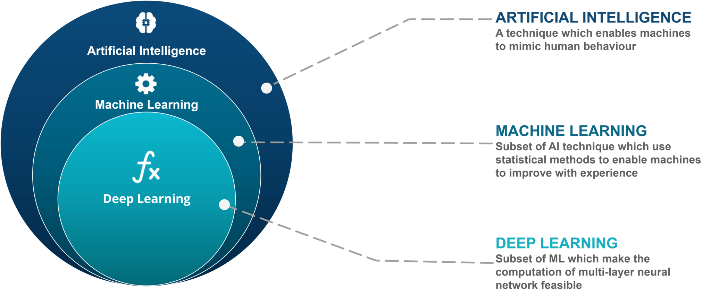
AI vs ML vs DL

Slide 7
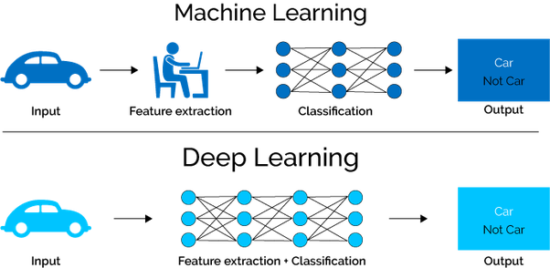
ML vs DL

Slide 8
Use Cases for Machine Learning & Deep Learning

Slide 9
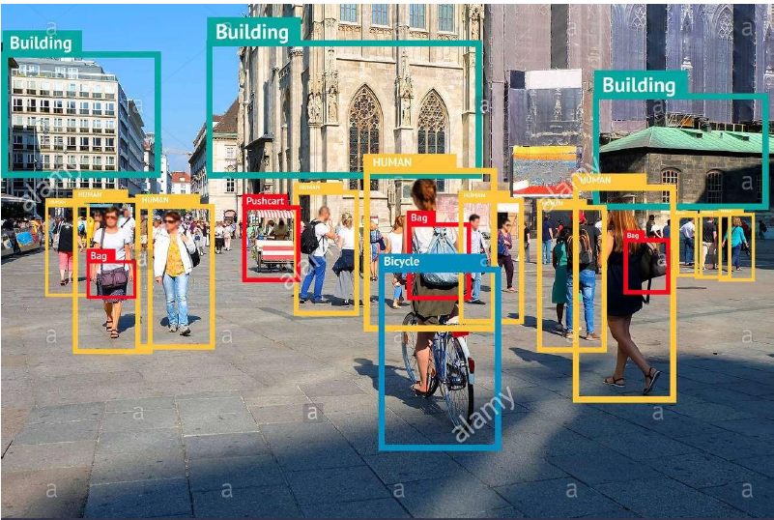
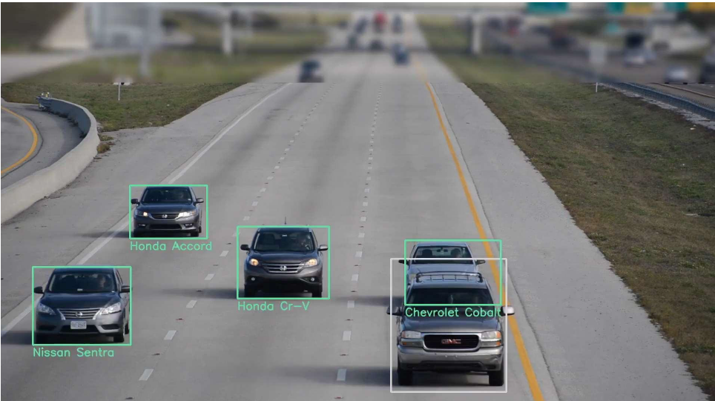

Slide 10
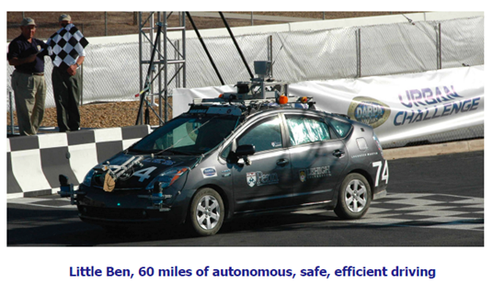
Application of Deep Learning
Detecting faces in images
MRI image analysis
Images Recommendation system
Images Search engines
Handwriting recognition
Scene classification
Autonomous vehicles
Self Driving Car

Slide 11
Classification of Deep Learning
Supervised
Unsupervised
Artificial Neural Network
Convolutional neural network
Recurrent neural network
Boltzmann machine Vs Deep BM
Self organizing maps
Autoencoder
GAN (Generative Adversarial Network)
Deep Q Learning
Pre Train Model

Slide 12
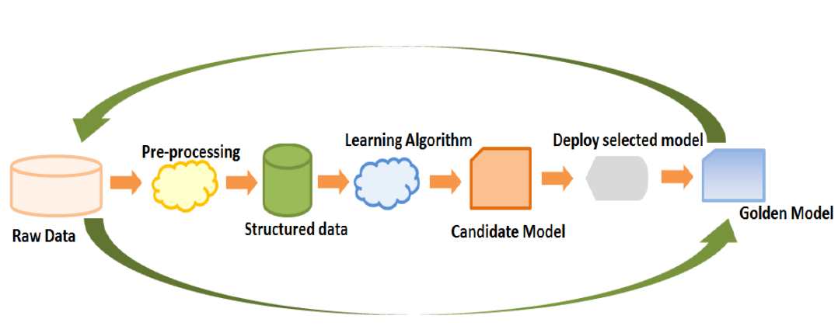
Deep Learning Process-flow

Slide 13
Any Question ?

Slide 14

Take a Break !!!

Slide 15
Artificial Neural Network

Slide 16
Supervised Unsupervised Reinforcement Learning
Artificial Neural Network
Regression and Classification

Slide 17
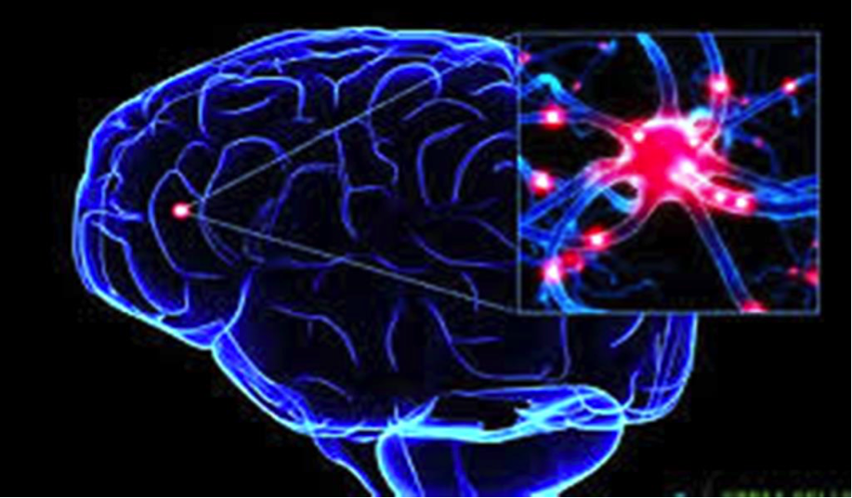
What is Neural ?

Slide 18
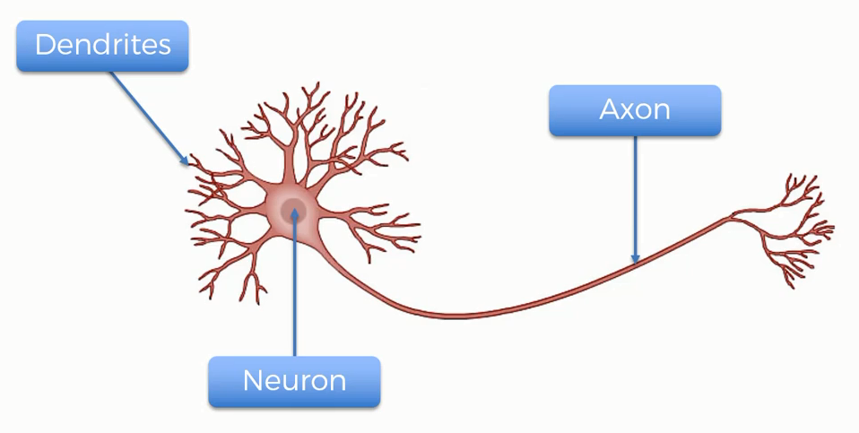
How Neural Works?

Slide 19
Perceptron

Slide 20
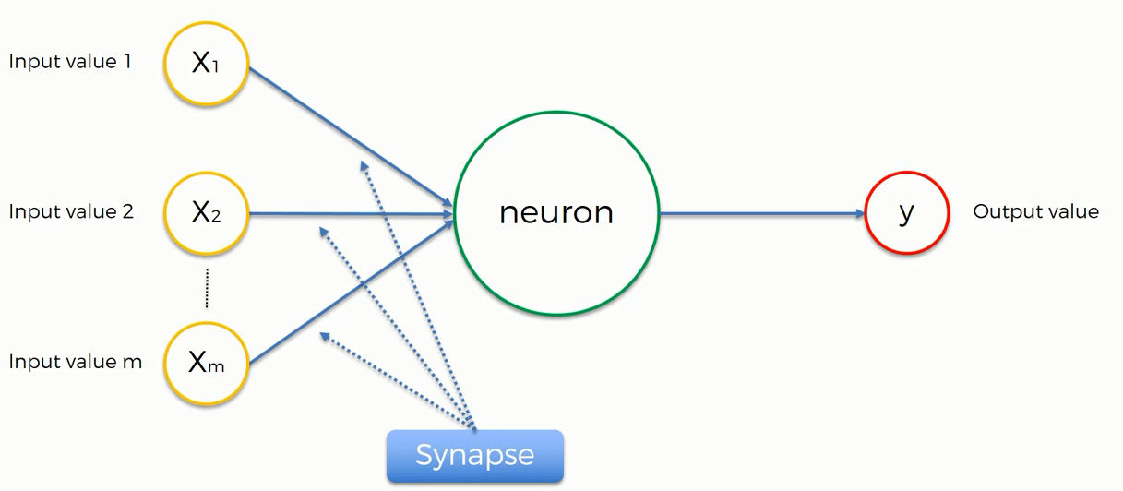

Perceptrons
Normalize/Standardize
$$\sum_{i=x}^{m}{wi xi}$$
Applying Activation Function

Slide 21
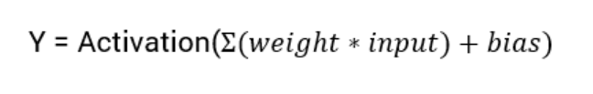
What is an Activation Function?
Activation functions are an extremely important feature of the artificial neural networks. They basically decide whether a neuron should be activated or not. Whether the information that the neuron is receiving is relevant for the given information or should it be ignored.
The activation function is the non linear transformation that we do over the input signal. This transformed output is then seen to the next layer of neurons as input.
Linear Activation Function
Non Linear Activation Function

Slide 22
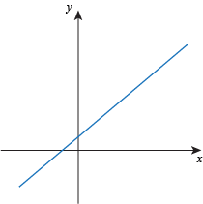
What is an Activation Function?
Linear Function
The function is a line or linear. Therefore, the output of the functions will not be confined between any range
Non Linear Function
Threshold
Sigmoid
Tanh
ReLU
Leaky ReLU
SoftMax
They make it easy for the model to generalize or adapt with variety of data and to differentiate between the output
The Nonlinear Activation Functions are mainly divided on the basis of their range or curves

Slide 23
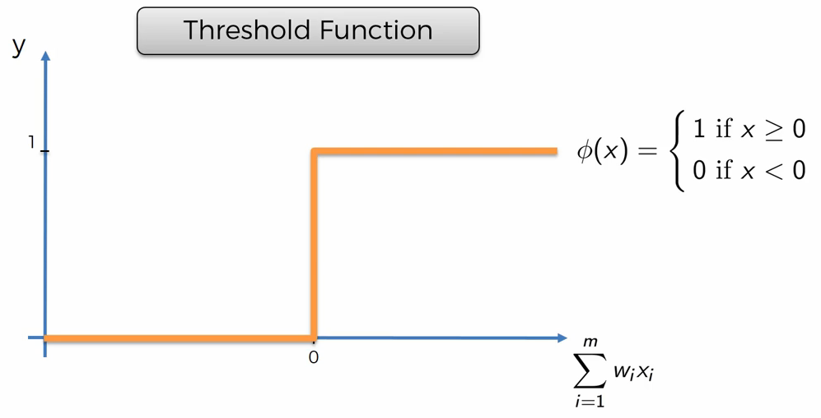
Threshold Function?

Slide 24
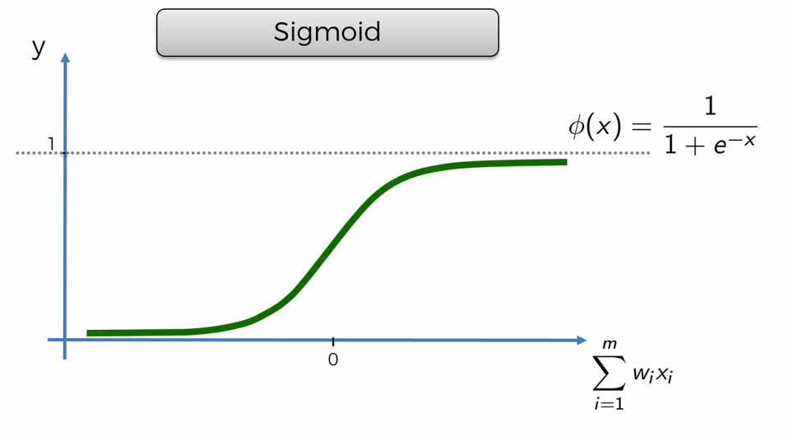
Sigmoid Function?
The Sigmoid Function curve looks like a S-shape
This function reduces extreme values or outliers in data without removing them.
It converts independent variables of near infinite range into simple probabilities between 0 and 1, and most of its output will be very close to 0 or 1.

Slide 25
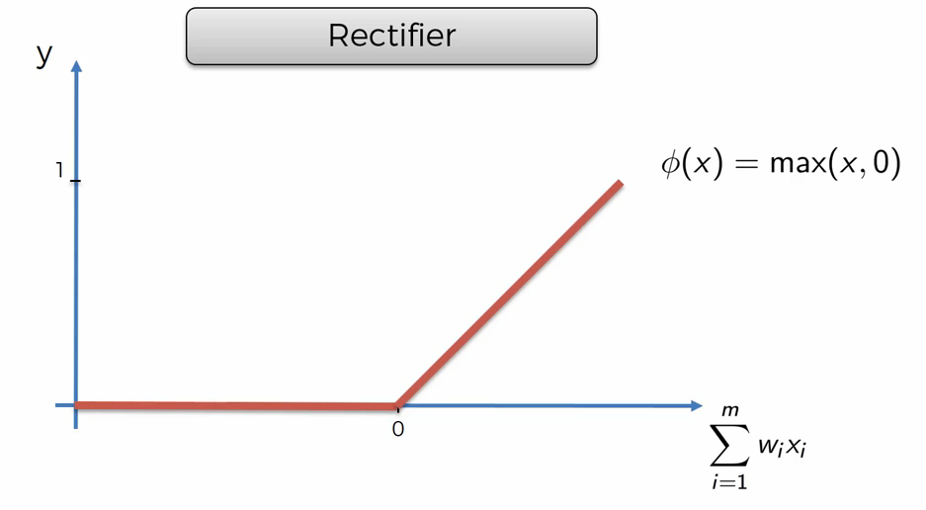
Rectifier (Relu) Function?
ReLU is the most widely used activation function while designing networks today. First things first, the ReLU function is non linear, which means we can easily backpropagate the errors and have multiple layers of neurons being activated by the ReLU function.

Slide 26
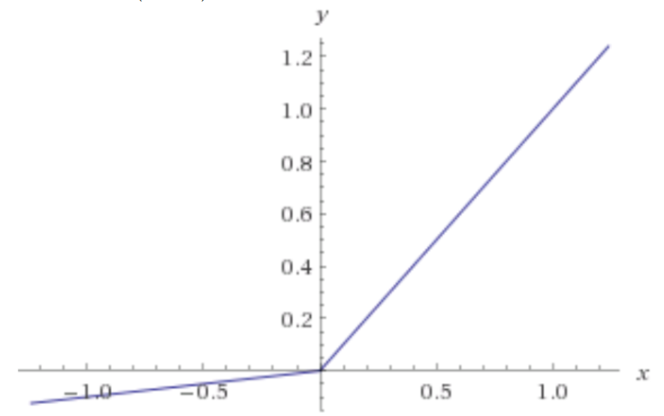
Leaky Relu Function?
Leaky ReLU function is nothing but an improved version of the ReLU function. As we saw that for the ReLU function, the gradient is 0 for x<0, which made the neurons die for activations in that region. Leaky ReLU is defined to address this problem. Instead of defining the Relu function as 0 for x less than 0, we define it as a small linear component of x.
What we have done here is that we have simply replaced the horizontal line with a non-zero, non-horizontal line. Here a is a small value like 0.01 or so.

Slide 27
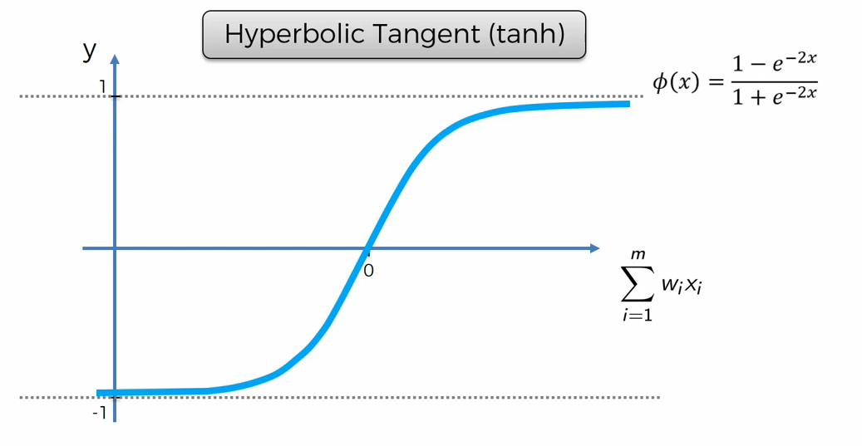
Hyperbolic or Tangent Function?
tanh is a hyperbolic trigonometric function
The tangent represents a ratio between the opposite and adjacent sides of a right triangle, tanh represents the ratio of the hyperbolic sine to the hyperbolic cosine: tanh(x) = sinh(x) / cosh(x)
Unlike the Sigmoid function, the normalized range of tanh is –1 to 1 The advantage of tanh is that it can deal more easily with negative numbers

Slide 28
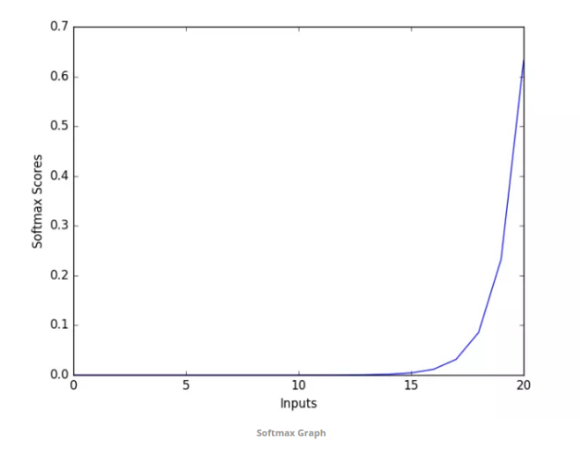
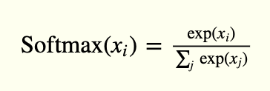
SoftMax Function (for Multiple Classification)?
SoftMax function calculates the probabilities distribution of the event over ‘n’ different events. In general way of saying, this function will calculate the probabilities of each target class over all possible target classes. Later the calculated probabilities will be helpful for determining the target class for the given inputs.
The main advantage of using Softmax is the output probabilities range. The range will 0 to 1, and the sum of all the probabilities will be equal to one. If the softmax function used for multi-classification model it returns the probabilities of each class and the target class will have the high probability.
The formula computes the exponential (e-power) of the given input value and the sum of exponential values of all the values in the inputs. Then the ratio of the exponential of the input value and the sum of exponential values is the output of the softmax function.

Slide 29
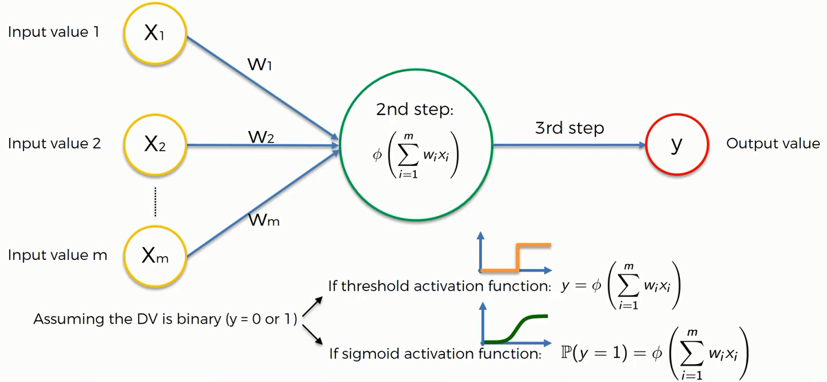
Activation Function Example

Slide 30
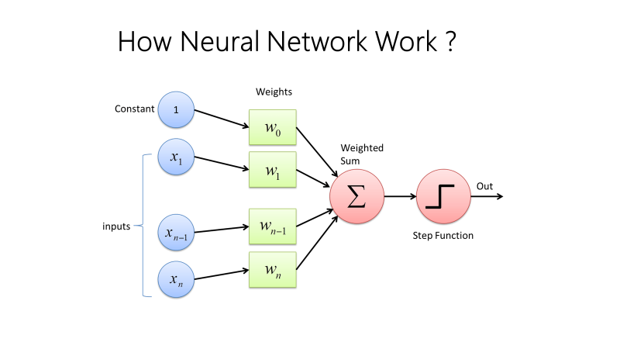

Slide 31
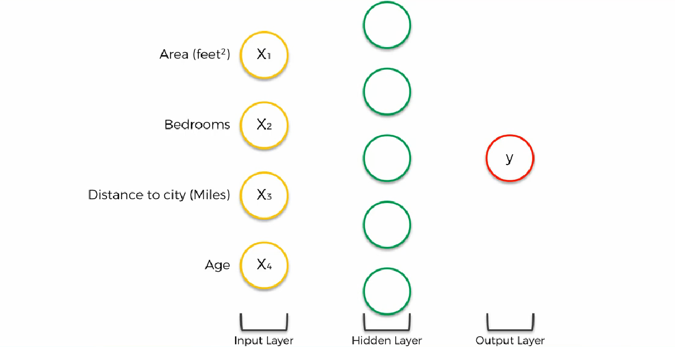
How Neural Network Work with many neurons

Slide 32
Back Propagation in deep learning
Back-propagation is the essence of neural net training. It is the method of fine-tuning the weights of a neural net based on the error rate obtained in the previous epoch (i.e., iteration). Proper tuning of the weights allows you to reduce error rates and to make the model reliable by increasing its generalization.
Backpropagation is a short form for "backward propagation of errors." It is a standard method of training artificial neural networks. This method helps to calculate the gradient of a loss function with respects to all the weights in the network.

Slide 33
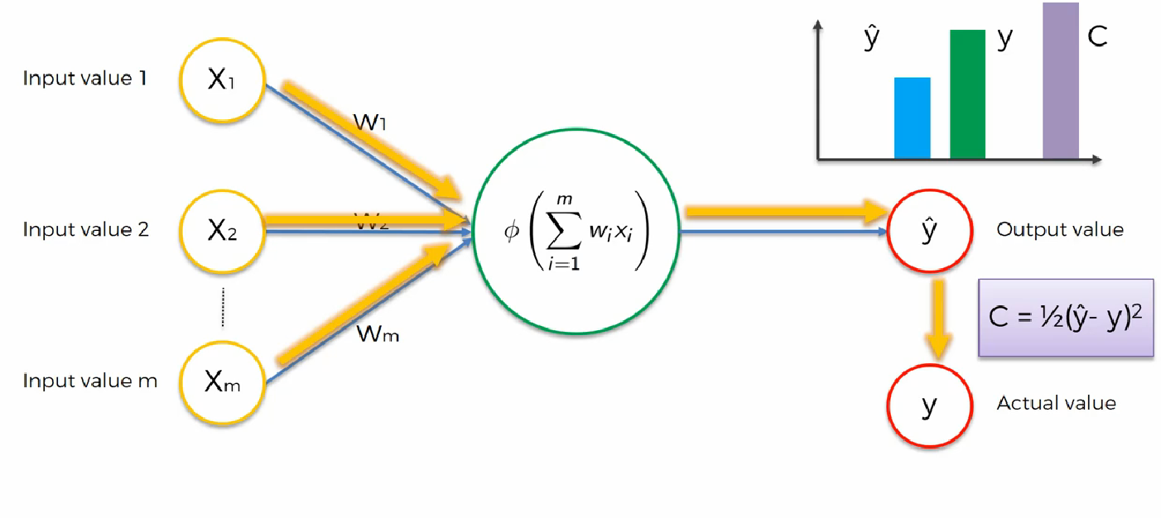
Back Propagation in deep learning ?

Slide 34
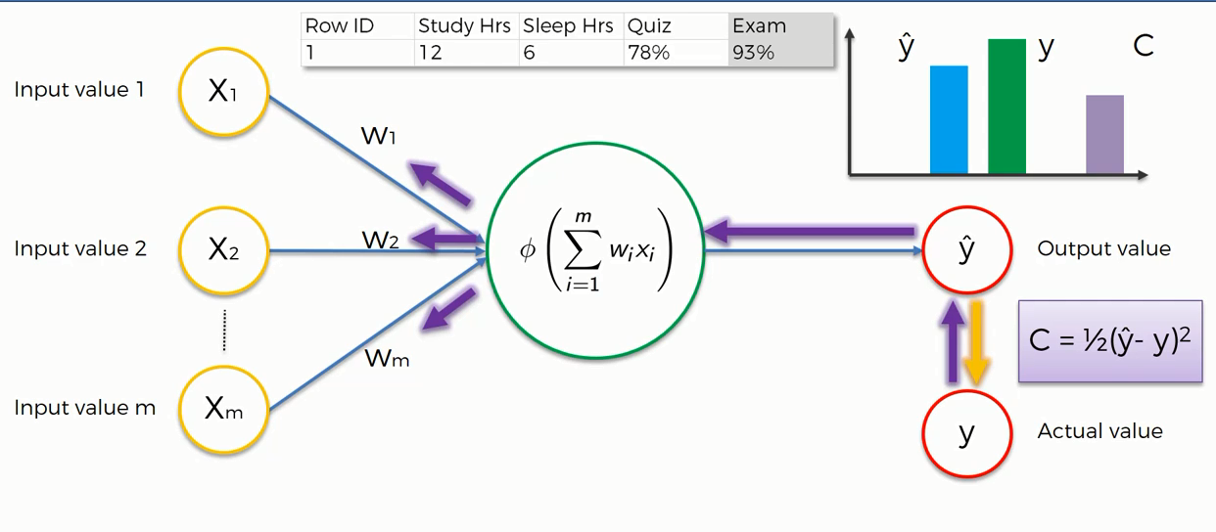
Back Propagation in deep learning ?

Slide 35
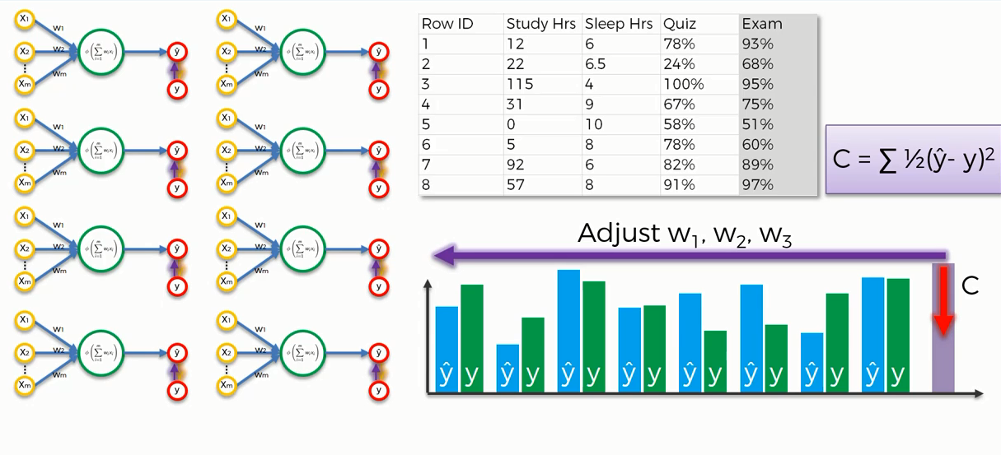
Back Propagation in deep learning (epoch)

Slide 36
Take a Break !!!

Slide 37
What is Bias ?
Bias is just like an intercept added in a linear equation. It is an additional parameter in the Neural Network which is used to adjust the output along with the weighted sum of the inputs to the neuron. Moreover, bias value allows you to shift the activation function to either right or left.
Output = sum (weights * inputs) + bias
The output is calculated by multiplying the inputs with their weights and then passing it through an activation function like the Sigmoid function, etc. Here, bias acts like a constant which helps the model to fit the given data. The steepness of the Sigmoid depends on the weight of the inputs, a simpler way to understand bias is through a constant c of a linear function.
y =mx + c

Slide 38
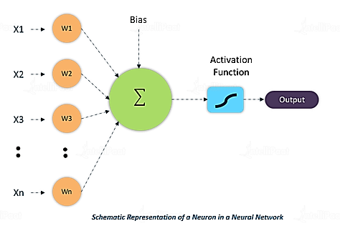
What is Bias ?
W * x + b

Slide 39
What is Gradient Descent (BGD)
Gradient Descent is an optimization technique that is used to improve deep learning and neural network-based models by minimizing the cost function.
Gradient Descent is a process that occurs in the backpropagation phase where the goal is to continuously resample the gradient of the model’s parameter in the opposite direction based on the weight w, updating consistently until we reach the global minimum of function J(w).
More Precisely, Gradient descent is an algorithm, which is used to iterate through different combinations of weights in an optimal way.....to find the best combination of weights which has a minimum error.

Slide 40
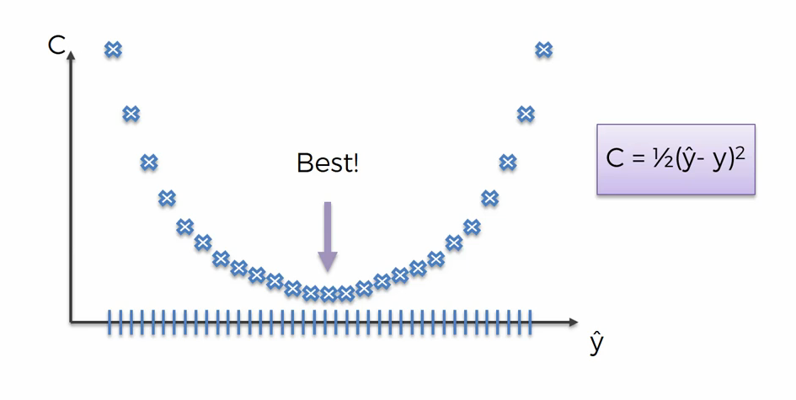
Brute force algorithm
Curse of dimensionality
Brute Force Algorithms refers to a programming style that does not include any shortcuts to improve performance, but instead relies on sheer computing power to try all possibilities until the solution to a problem is found. A classic example is the traveling salesman problem (TSP).

Slide 41
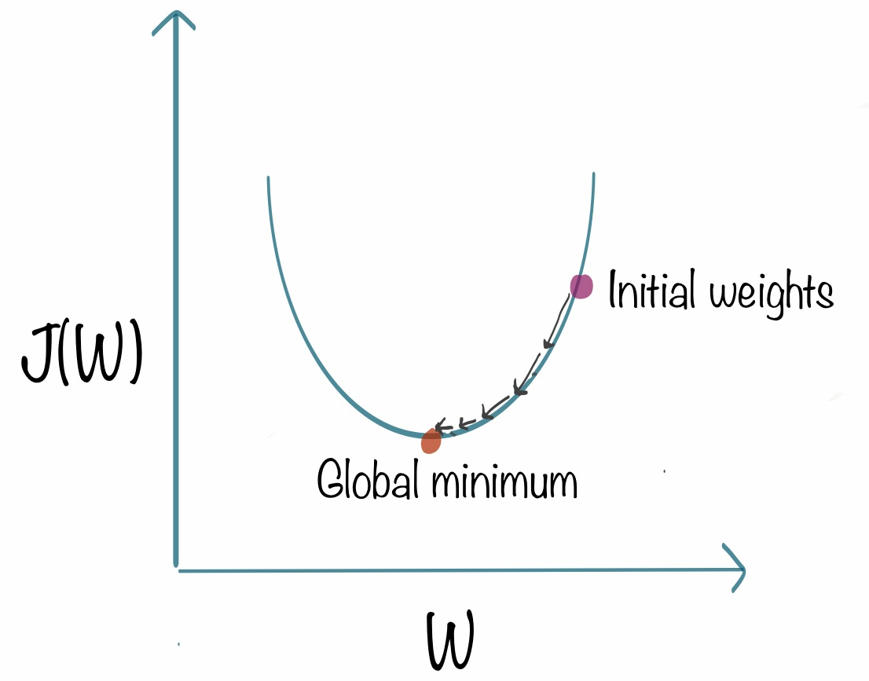
What is Gradient Descent ?

Slide 42
Stochastic gradient descent
The word ‘stochastic‘ means a system or a process that is linked with a random probability. Hence, in Stochastic Gradient Descent, a few samples are selected randomly instead of the whole data set for each iteration. In Gradient Descent, there is a term called “batch” which denotes the total number of samples from a dataset that is used for calculating the gradient for each iteration. In typical Gradient Descent optimization, like Batch Gradient Descent, the batch is taken to be the whole dataset. Although, using the whole dataset is really useful for getting to the minima in a less noisy or less random manner, but the problem arises when our datasets get really huge.

Slide 43
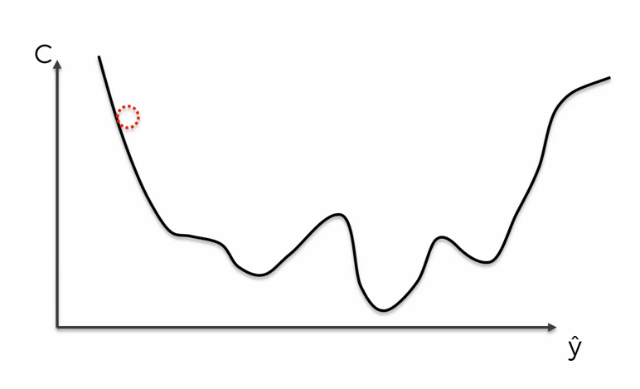
Stochastic gradient descent
Stochastic gradient descent (often abbreviated SGD) is an iterative method for optimizing an objective function with suitable smoothness properties (e.g. differentiable or subdifferentiable). ~Convex Loss function~

Slide 44
Stochastic gradient descent

Slide 45
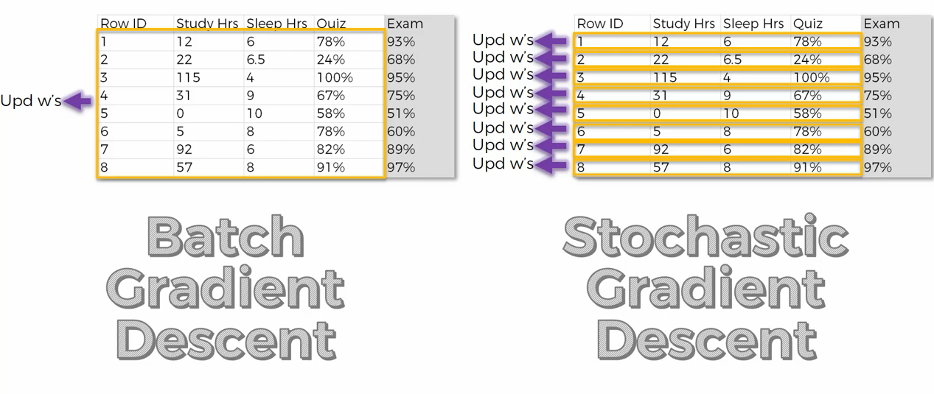
Stochastic gradient descent

Slide 46
Mini Batch gradient descent
Mini-batch gradient descent is a variation of the gradient descent algorithm that splits the training dataset into small batches that are used to calculate model error and update model coefficients.
Implementations may choose to sum the gradient over the mini-batch which further reduces the variance of the gradient.
Mini-batch gradient descent seeks to find a balance between the robustness of stochastic gradient descent and the efficiency of batch gradient descent. It is the most common implementation of gradient descent used in the field of deep learning.

Slide 47
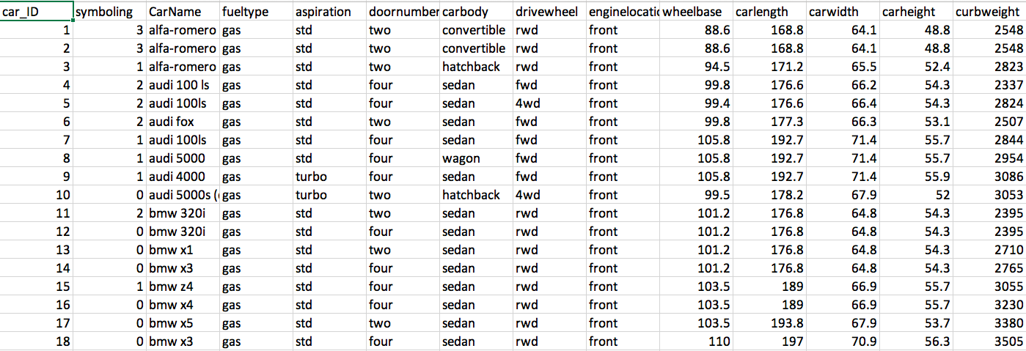
Mini Batch gradient descent
BGD SGD MBGD

Slide 48

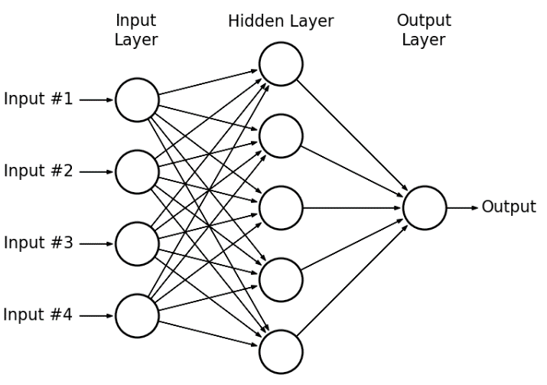
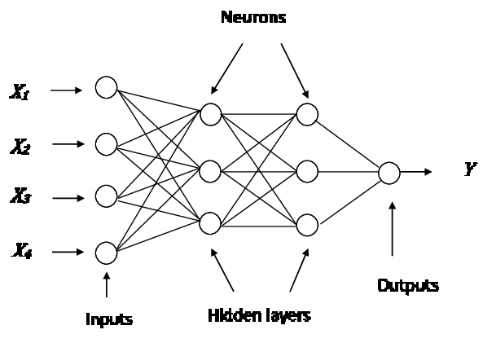
Perceptron (Multilayer Perceptron) & ANN
A perceptron is a network with two layers, one input and one output. ... Artificial neural network, which has input layer, output layer, and two or more trainable weight layers (consisting of Perceptron's) is called multilayer perceptron or MLP.

Slide 49
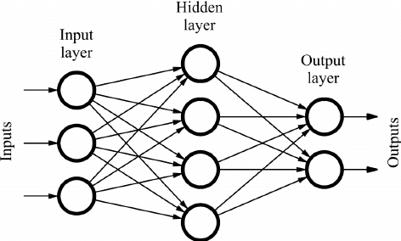
Feedforward Neural Network
It is one of the simplest types of artificial neural networks. In a feedforward neural network, the data passes through different input nodes until it reaches the output node. In other words, the data moves in only one direction from the first range until it reaches the output node. It is also known as a front propagating wave which is usually obtained using a graded activation function. Unlike more complex types of neural networks, backpropagation and data move in only one direction. A feedforward neural network may consist of a single layer or may contain hidden layers. In a feedful neural network, the products of the inputs and their weights are calculated. This is then fed to the output.
whereas
Backpropagation is a training algorithm consisting of 2 steps:
Feedforward the values.
Calculate the error and propagate it back to the earlier layers.

Slide 50
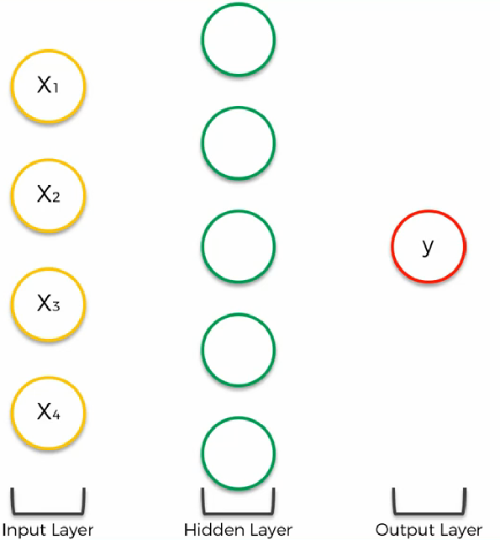
Artificial neural network working principle

Slide 51
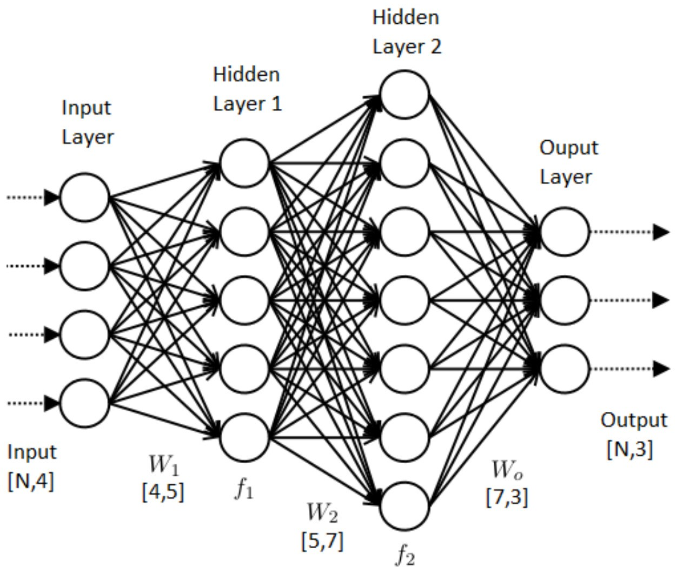
Artificial neural network working principle

Slide 52
Artificial neural network working Step by Step
STEP 1: Randomly initialize the weights to small numbers close to 0 (but not 0)
STEP 2: Input the first observation of your dataset in the input layer, each feature in one input node.
STEP 3: Forward-Propagation: from left to right, the neurons are activated in a way that the impact of each neuron's activation is limited by the weights. Propagate the activations until getting the predicted result y.
STEP 4: Compare the predicted result to the actual result. Measure the generated error.
STEP 5: Back-Propagation: from right to left, the error is back-propagated.
Update the weights according to how much they are responsible for the error. The learning rate decides by how much we update the weights.
STEP 6: Repeat Steps 1 to 5 and update the weights after each observation (Reinforcement Learning).
Or: Repeat Steps 1 to 5 but update the weights only after a batch of observations (Batch Learning).

Slide 53
Keras
Keras is a high-level neural networks API, written in Python and capable of running on top of TensorFlow, CNTK, or Theano. It was developed with a focus on enabling fast experimentation. Being able to go from idea to result with the least possible delay is key to doing good research. Use Keras if you need a deep learning library that:
Allows for easy and fast prototyping (through user friendliness, modularity, and extensibility).
Supports both convolutional networks and recurrent networks, as well as combinations of the two.
Runs seamlessly on CPU, GPU and TPU.

Slide 54
Demo

Slide 55
Any Question ?

Slide 56
Take a Break !!!

